Slide 1
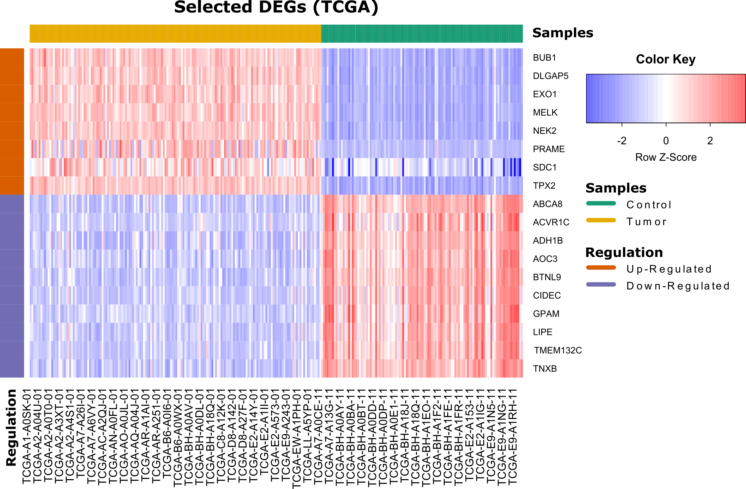
Fig. S-1: The heatmap of 18 selected differentially expressed genes in BLBC versus control group.

Slide 2
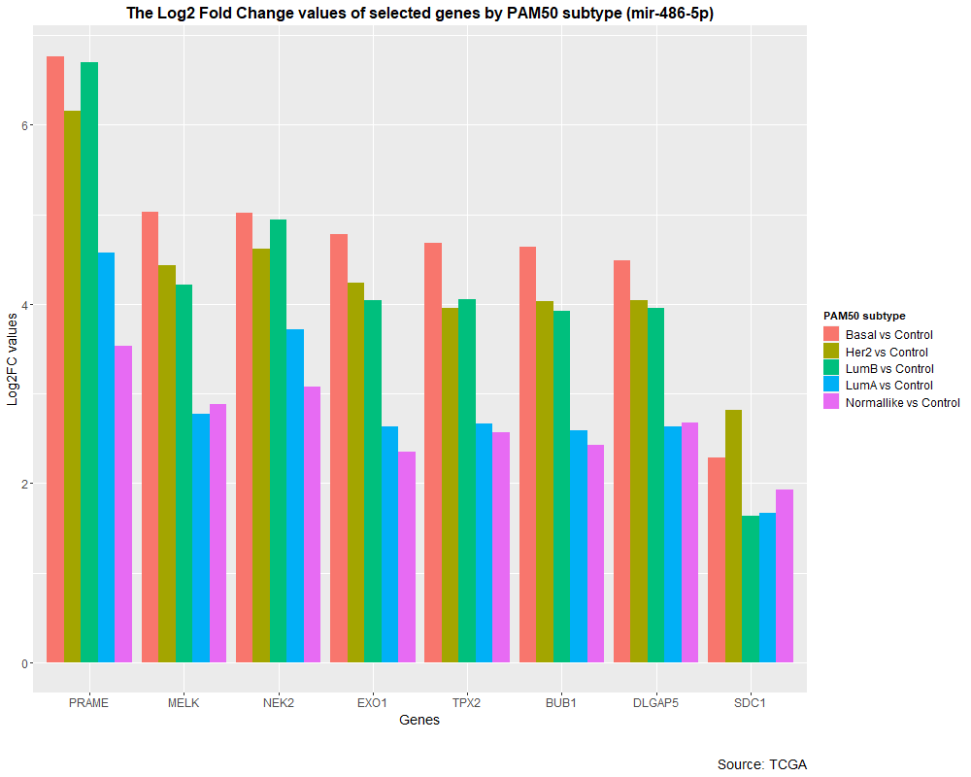
Fig. S-2a: A distinct alteratered expression level of miR-486-5p potentially target genes in PAM50 subgroups from normal-like group to the BLBC group.

Slide 3
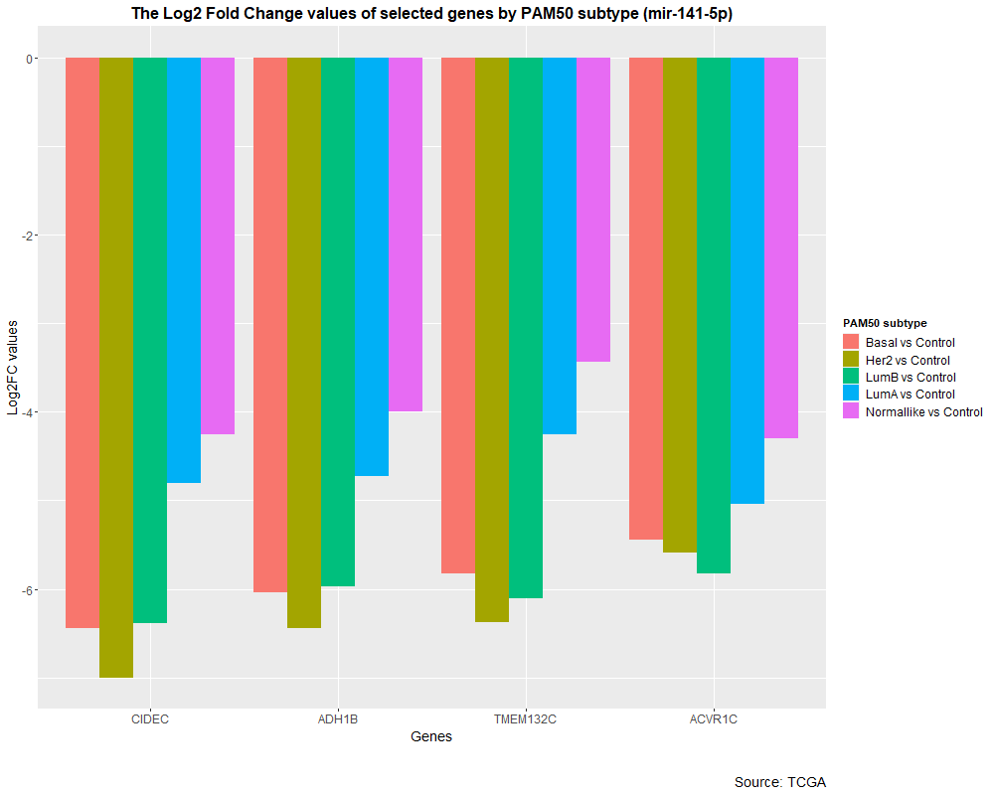
Fig. S-2b: A distinct alteratered expression level of miR-141-5p potentially target genes in PAM50 subgroups from normal-like group to the BLBC group.

Slide 4
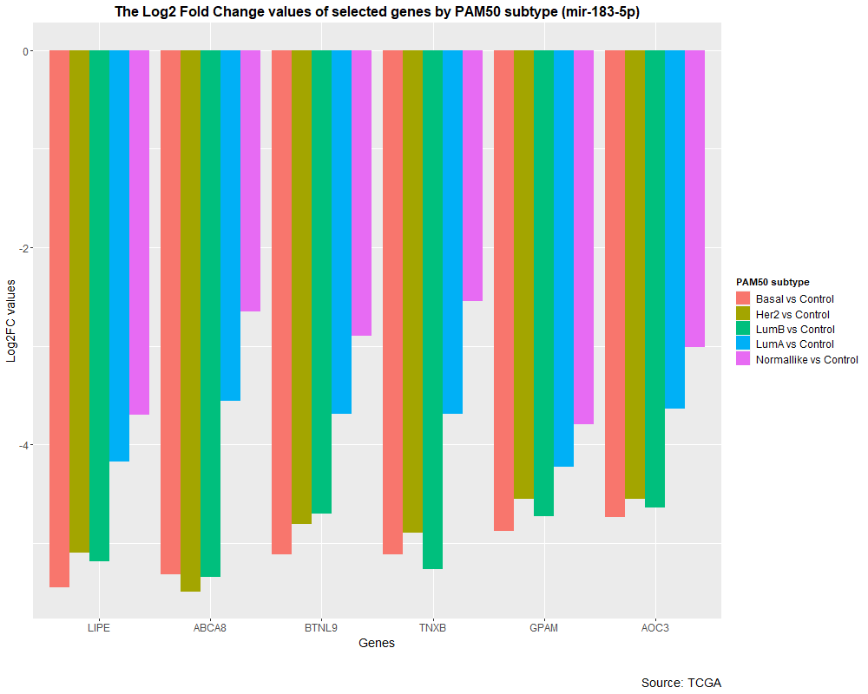
Fig. S-2c: A distinct alteratered expression level of miR-183-5p potentially target genes in PAM50 subgroups from normal-like group to the BLBC group.

Slide 5
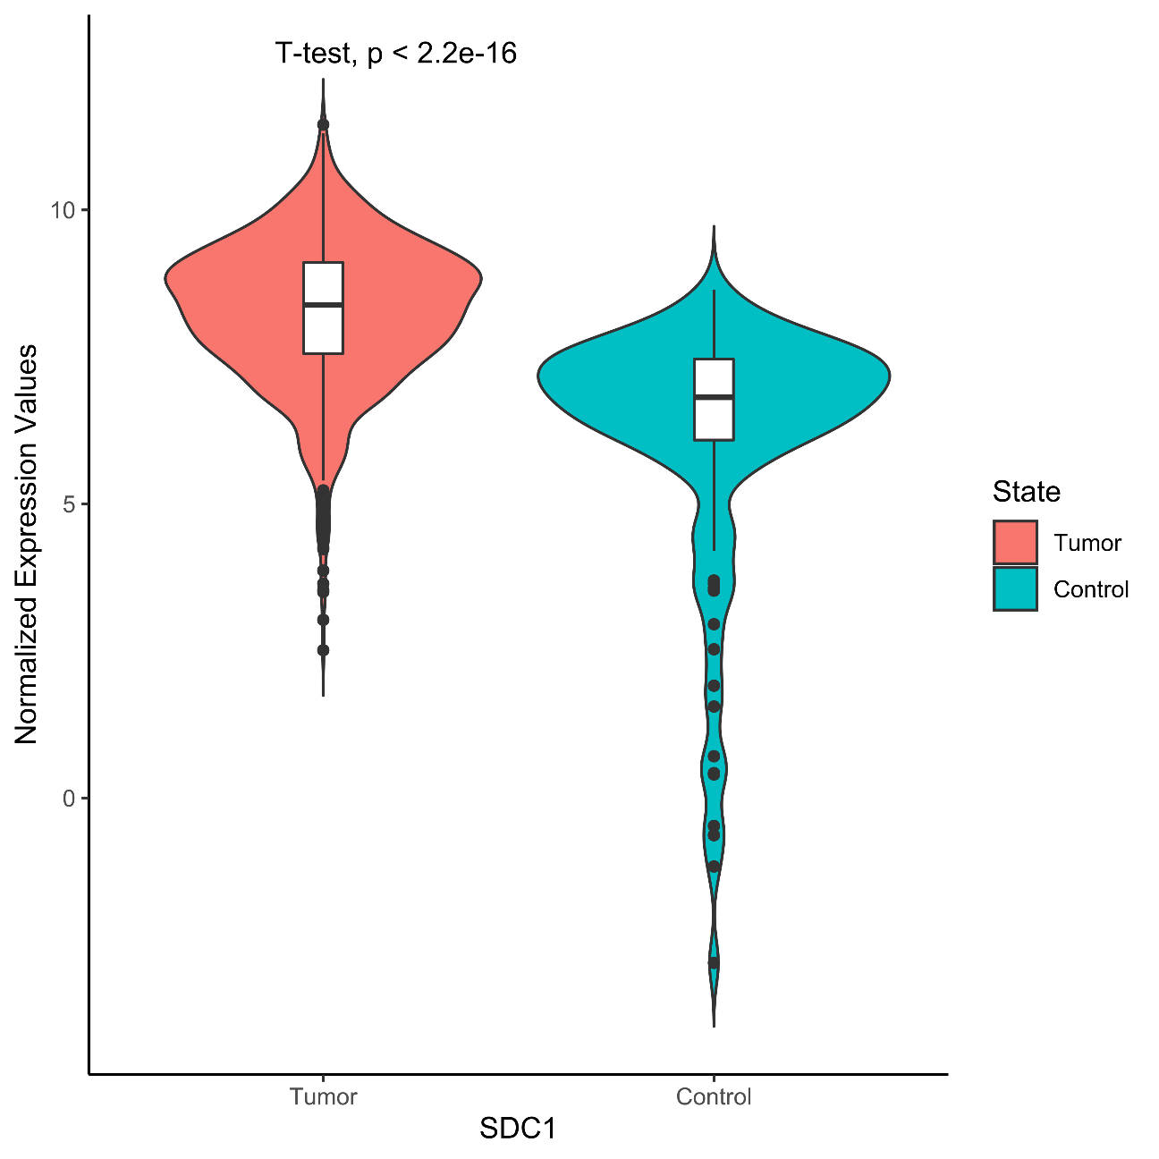
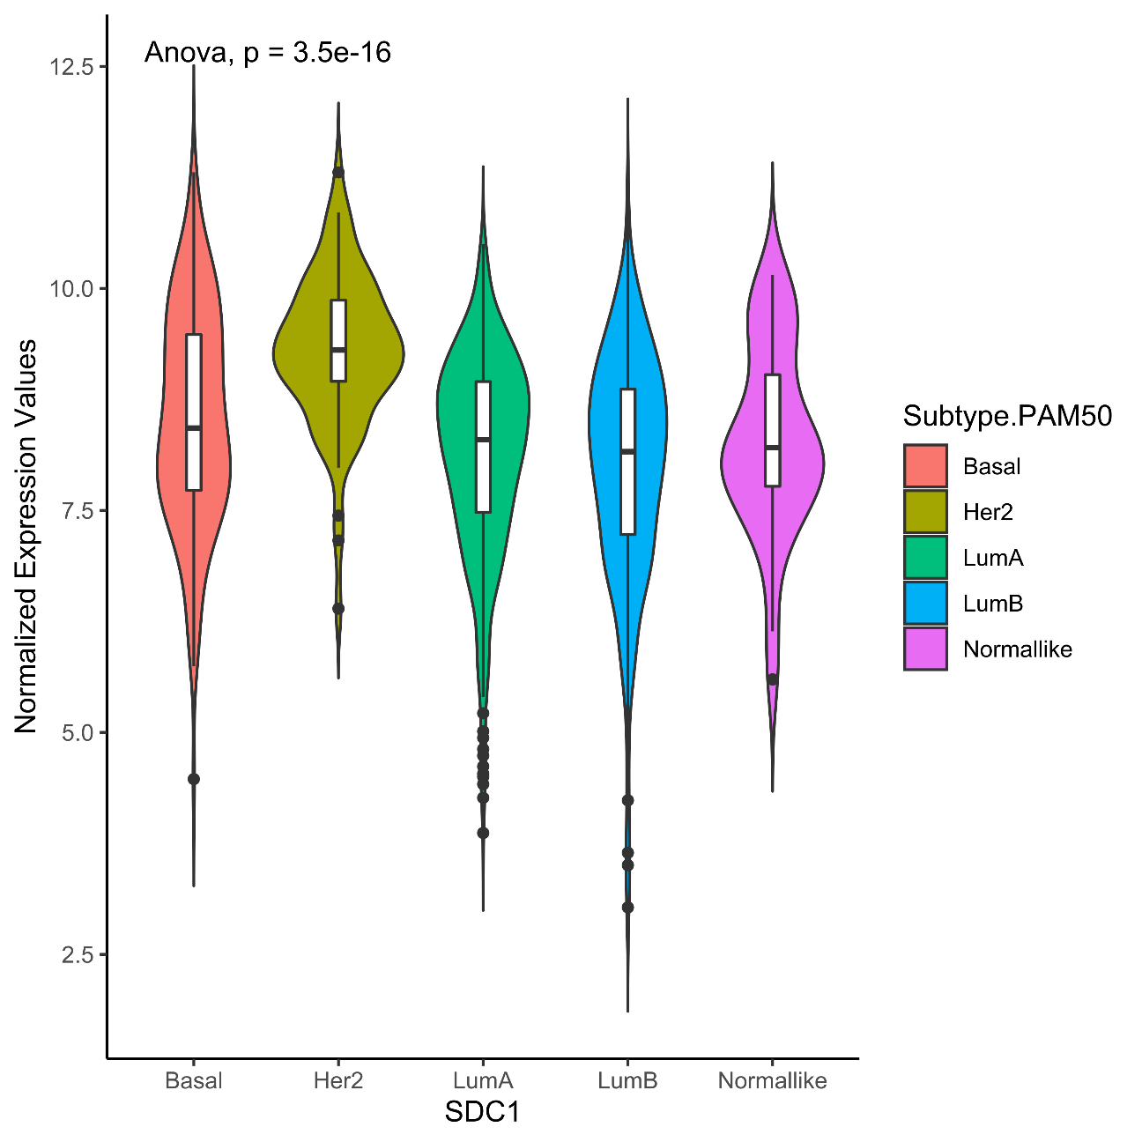
TCGA
Fig. S-3a: The combined violin and box plots for the normalized expression values of SDC1 gene in tumor versus normal tissue and PAM50 subtypes.

Slide 6
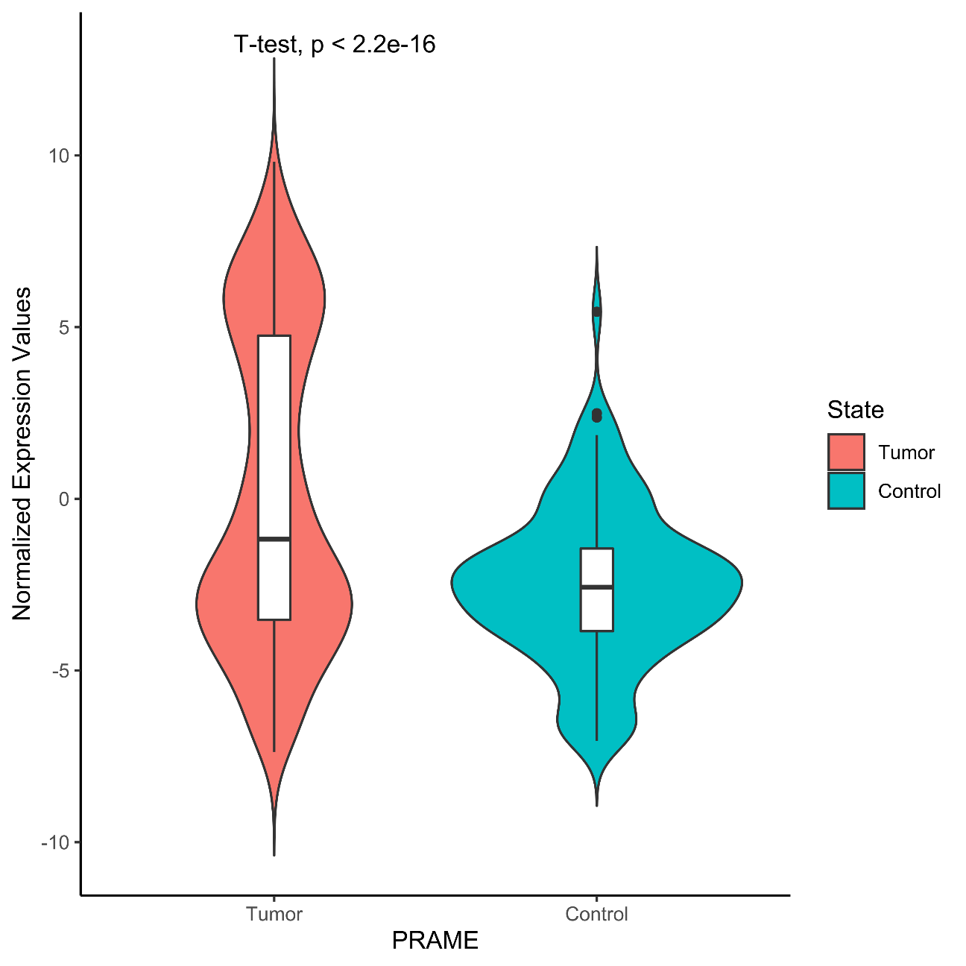
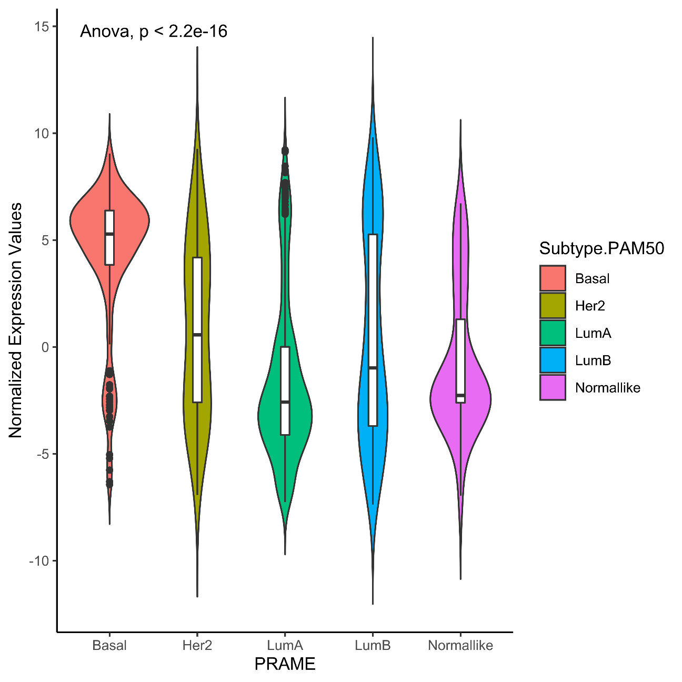
TCGA
Fig. S-3b: The combined violin and box plots for the normalized expression values of PRAME gene in tumor versus normal tissue and PAM50 subtypes.

Slide 7
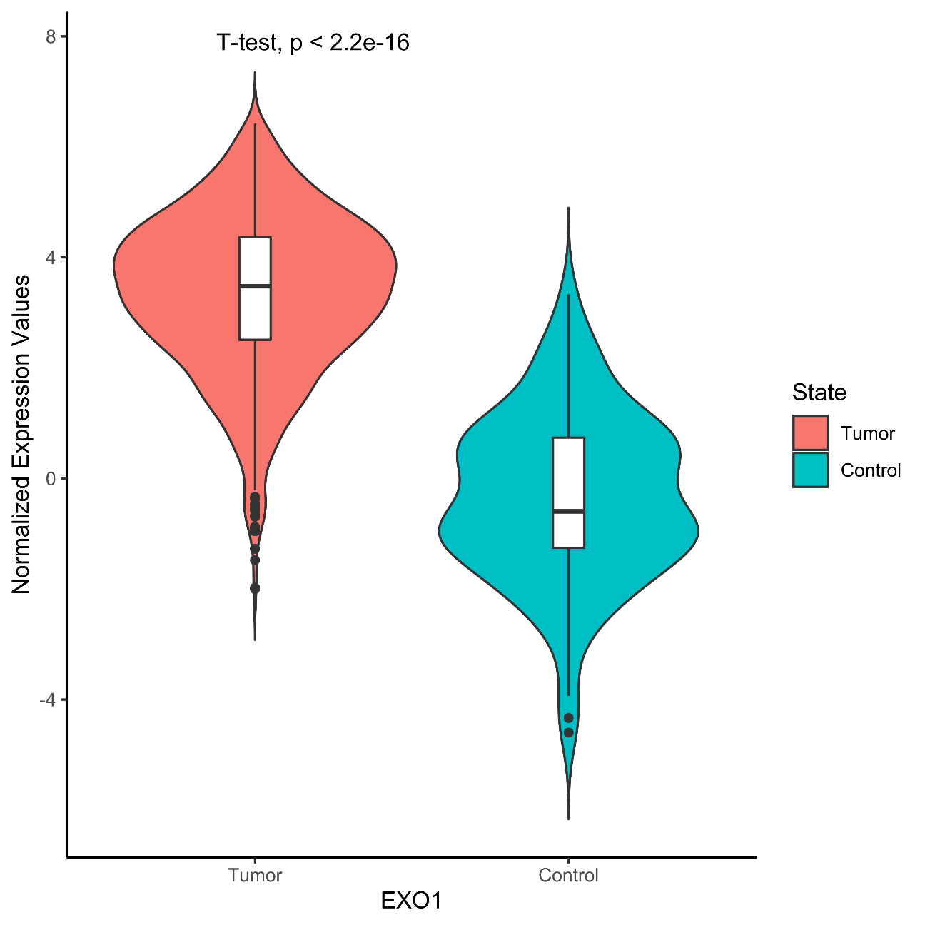
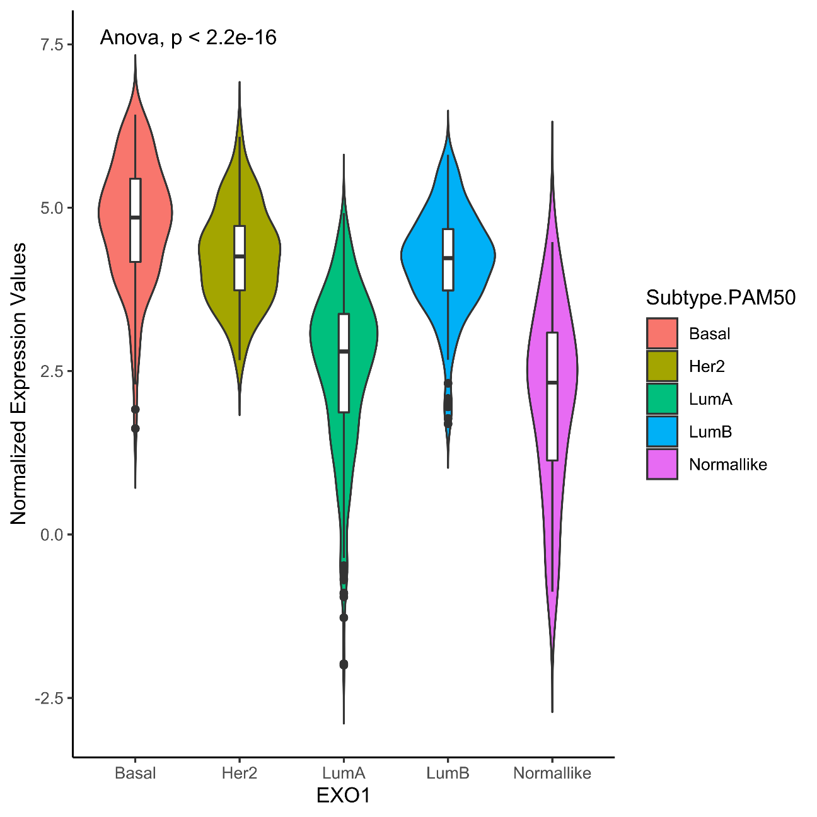
TCGA
Fig. S-3c: The combined violin and box plots for the normalized expression values of EXO1 gene in tumor versus normal tissue and PAM50 subtypes.

Slide 8
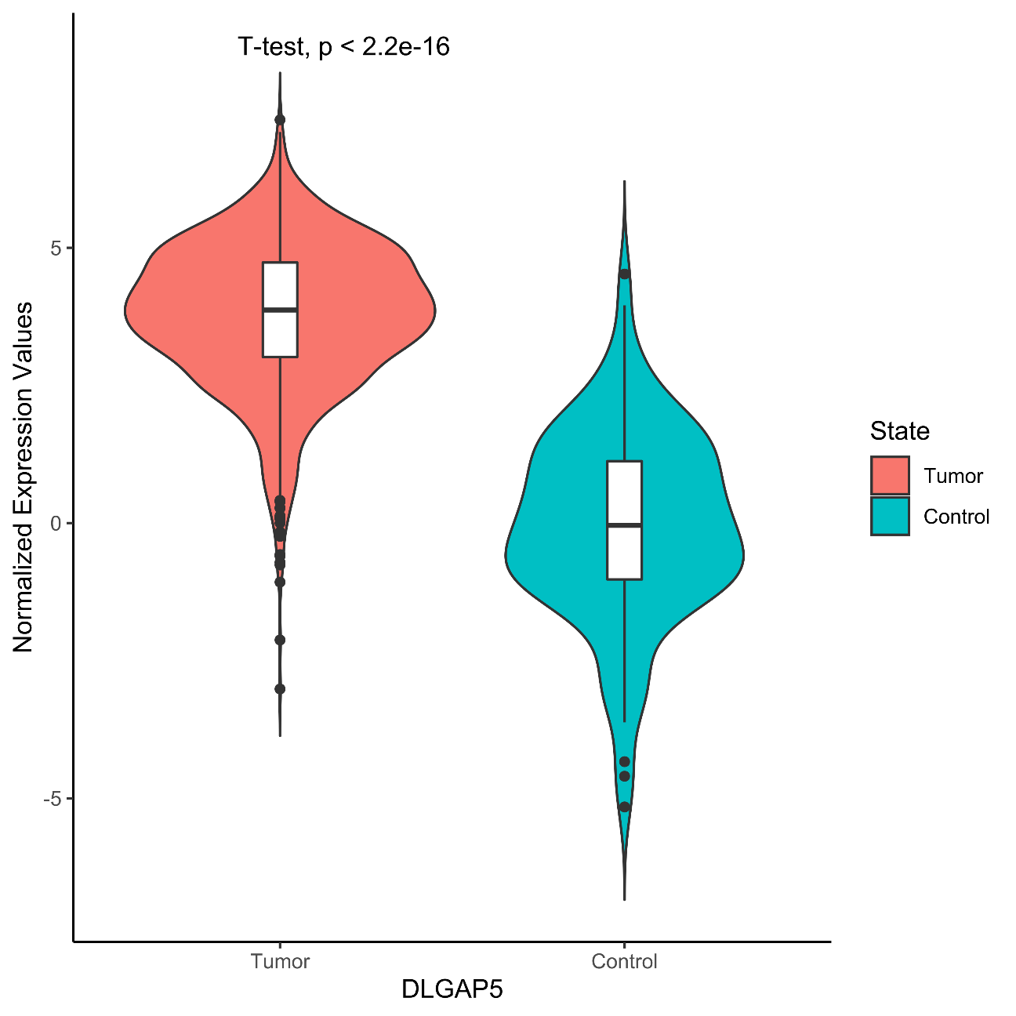
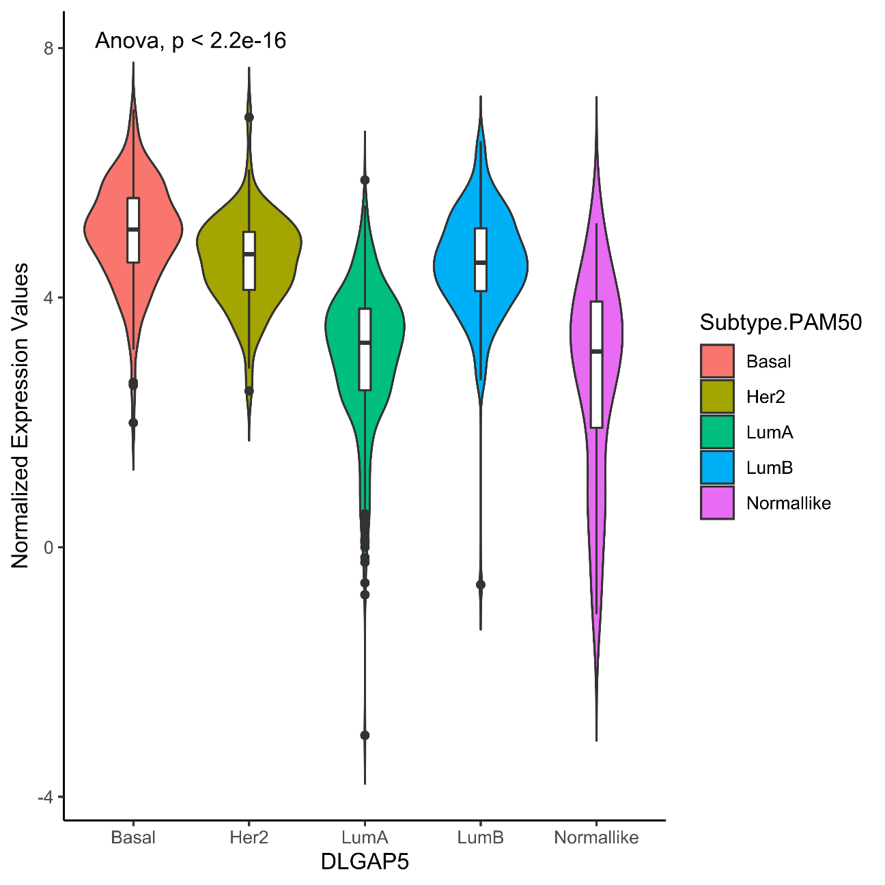
TCGA
Fig. S-3d: The combined violin and box plots for the normalized expression values of DLGAP5 gene in tumor versus normal tissue and PAM50 subtypes.

